Slide 1
Preparation for European XFEL upgrade
Thomas Tschentscher
July 16, 2026
thomas.tschentscher@xfel.eu

Slide 2
Scope of this meeting & agenda
Primary target: provide information to you (and your staff …)
  What is our target and motivation
  What are the boundary conditions
  Which are the options
  How does the path to proposal and upgrade look alike
Secondary target: clarify current working point
  attempt mapping of European XFEL scientific applications to x-ray beam property phase space
Agenda for today
  Welcome & Intro
  Analysis of upgrade options (facility options, operations modes, comparison with other Facilities)
  Discussion
  Tea/coffee break
  Mapping of science applications <-> Beam properties [interactive / flipcharts]
  Open discussion, e.g. other techniques/technologies to be considered

Slide 3
Necessary ingredients for facility upgrade proposal
Science requirements
  Partly emerging from experiments done at European XFEL (or which cannot be done)
  Partly from recent science cases formulated for other X-ray FELs (LCLS-II-HE, UK-XFEL)
  Science workshops for an upgrade of European XFEL (to come …)
  Provision of more experiment time to enable more experiments/reduce over-demand
Technological opportunities
  Accelerator developments,
    E.g. through the ability to provide high repetition rates continuously, or
    Through the ability to provide smaller emittances, or similar.
  New FEL source developments
    Attosecond FEL schemes,
    Delivery of high photon energy FEL radiation,
    superconducting FELs, or
    XFELO, or similar.
  New science instruments/experimental techniques

Slide 4
Preparation of upgrade proposal is part of 2030⁺ Strategy
European XFEL lauched in 2024 its 2030⁺ Strategy.
2-level strategy: Harvesting science and developing opportunities.
New opportunities: mid-term improvements & long-term facility upgrade.
From May 2025; times to be adapted

Slide 5
Analysis of upgrade options

Slide 6
What is meant by this ?
Any upgrade proposal
  needs to be consistent with the current facility and its way of operation,
  needs to consider present installations,
  needs to be attractive to our (present and future) User communities,
  needs to be attractive for funding agencies (respond to science-political guidelines),
  needs to be attractive to ourselves,
  needs to be technically feasible,
  needs to be publicly acceptable (sustainability, no/minimal direct impact to public),
  and last not least
  needs to be financed.
How to address this
  Technical realization
  Technical realization
  Science workshops, UC support statements, workshop reports → Science case
  Societal challenges, innovation potential, socio-economic impact, …
  Involving internal experts
  Technical realization
  Ideally within present boundaries (PFV), other measures t.b.d.
  Shareholder engagement, potentially engaging with new shareholders

Slide 7
Target and motivation

Slide 8
Motivation for upgrading European XFEL
Offer new opportunities for science applications following request by User communities
Offer better conditions for science applications following experience from current operation
Offer more instruments/beamtime to respond to proposal demand by User communities
Stay ‚state-of-the-art‘ and competitive in international context
Renew/refurbish aged components to increase facility lifetime
Scientific usage & user facility aspects are the critical drivers
Extending installation and/or performance of the accelerator, the FEL sources, the beamlines, the scientific instruments, and of the ‚user services‘ should be motivated by their scientific usage and the needs of the User community.
Technical advances and new installations/methods/techniques are important and needed to achieve certain performances, but should not be seen as the driver of the upgrade.

Slide 9
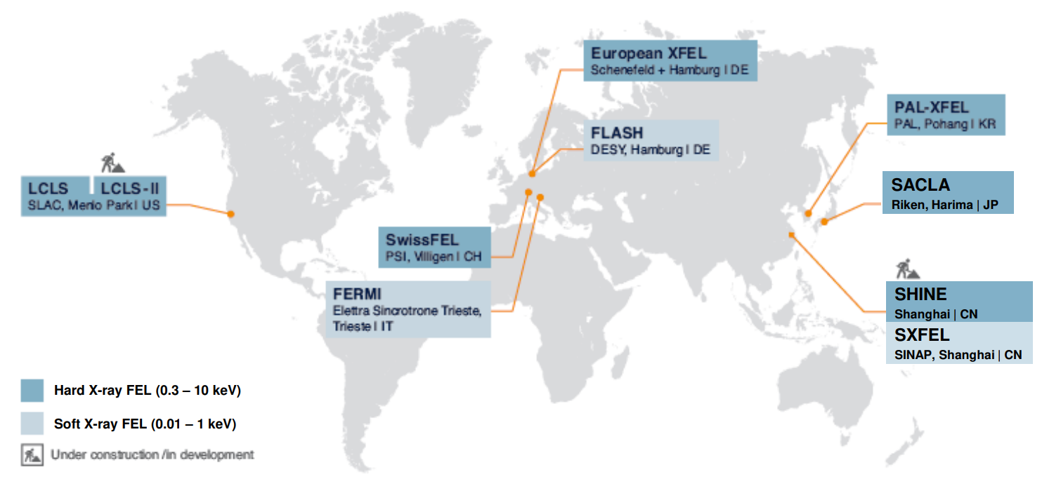
Landscape analysis I - Facilities
High repetition rate facilities
  FLASH, LCLS, SHINE, S3FEL
Hard x-ray facilities
  LCLS, SACLA, PAL-XFEL, SwissFEL, SHINE
Other specialties …
  Seeding/coherence: ELETTRA
  Laser-driven: EuPRAXIA, …
Proposed
  UKXFEL
  …
Map to be updated

Slide 10
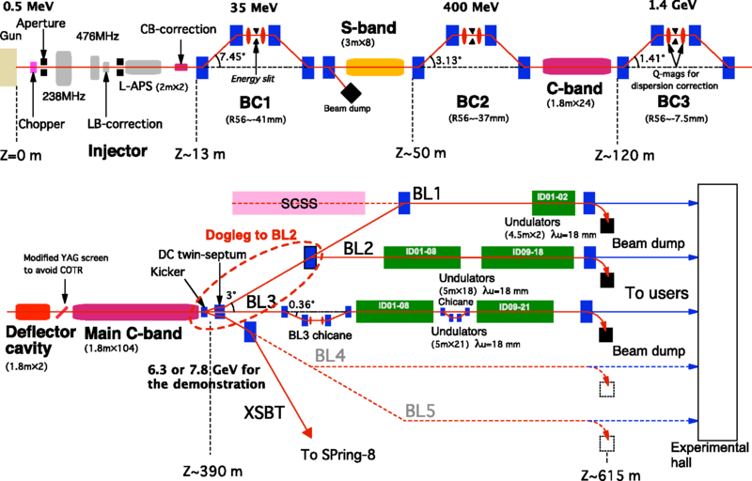
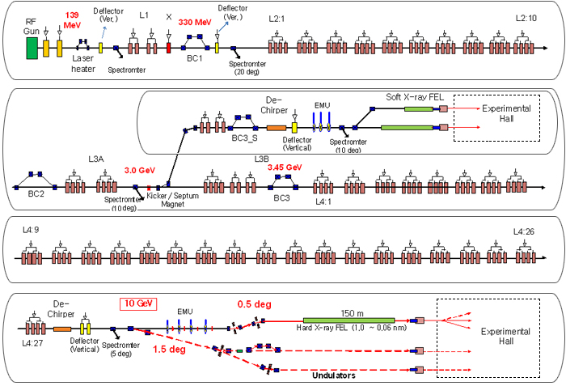

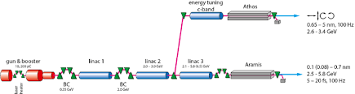
The HXR FEL landscape in 10 years
SACLA:
8 GeV NC 50 Hz, 2 undulators (+1 SXR fed by 0.5 GeV linac)
Upgrade: Space for 2 more undulators in hall, rumors for
upgrade to kHz NC RF, change to photo-injector
Biggest asset: world leading optics
PalFEL:
10 GeV NC 50 Hz, 2 undulators (SXR/ HXR)
Upgrade: ambitions for 3rd undulator, 2 bunch operation,
increase to 100 Hz
Biggest asset:
SwissFEL:
5.8 GeV NC 100 Hz two bunch, 2 undulators (SXR/HXR)
Upgrade: injector rebuild, 7 GeV linac upgrade,
preparation for 3rd undulator
Biggest asset: tailored to special modes
Slide prepared by W. Decking (DESY)

Slide 11
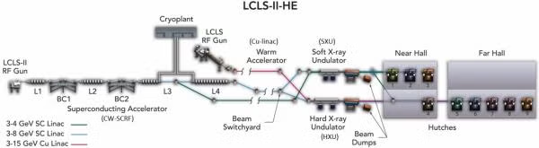
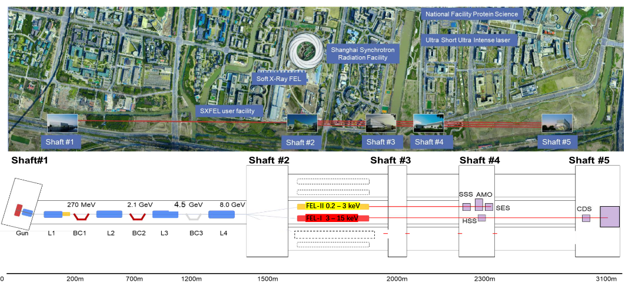
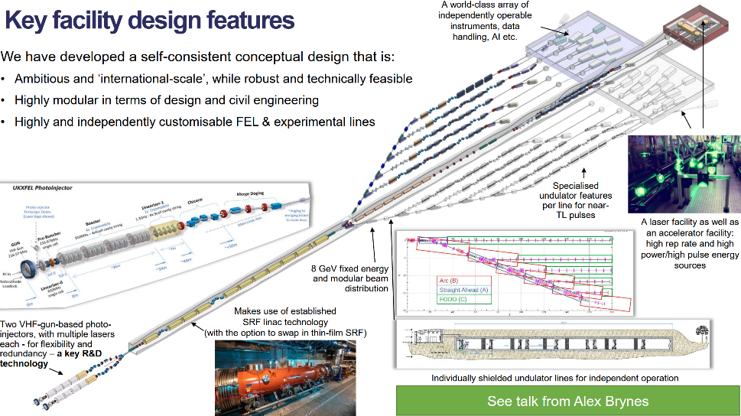
The HXR FEL landscape in 10 years
LCLS:
8 GeV SC CW, 14 GeV NC 60 Hz, 2 undulators (SXR/ HXR)
Upgrade: Low emittance injector for higher photon
energies & LCLS-X (more beamlines)
Biggest asset: CW accelerator for many beamlines,
NC high energy accelerator for high photon energies
SHINE:
8 GeV SC CW, 2 undulators (SXR/HXR)
Upgrade: Low emittance injector
& 3rd short period (superconducting) undulator
Biggest asset: Already three undulator tunnels build,
so extension to many beamlines straightforward
UKFEL (study):
8 GeV SC CW, 10 tailored radiators
Biggest asset: Thorough analysis of UK user needs and
match to tailored radiators
Slide prepared by W. Decking (DESY)

Slide 12
Landscape analysis II – Science drivers
Past/current cases
  ultrafast chemistry (nuclear dynamics …)
  structural life sciences
  material science,
  AMO fundamental physics
Recent cases (method-oriented)
  Attoseconds – Electron dynamics
  Non-linear spectroscopy - ???
  High resolution spectroscopy – Materials
  High photon energies – Materials
Recent cases (application oriented)
  ultrafast (material) processes – (3D) imaging
  material particles & aerosols – SPI
The scrutiny and development of the scientific drivers will be a very important part of the upgrade proposal.
This is only a start to categorize
scientific drivers/applications.

Slide 13
Targets for an upgrade proposal
Upgrade of European XFEL makes the facility attractive to User communities and funding agencies for a significant amount of time → European flagship RI
Following a first period of operation (approx. 20 years) the upgrade shall make the facility fit for another 20 years.
The upgrade proposal differs from (on-going) extensions of the present facility by scope, volume, and last not least source of funding :
  Upgrade vs. extensions:
    Extensions: new e-beam or x-ray diagnostic, new source modes or replacement of sources, new/refurbished instruments at existing sources
    Upgrades: Significant changes to accelerator, new sources, new beamlines/science instruments at new FELs, new tunnels and experiment halls
Cost for upgrade and operation of upgraded facility
  Expect substatial additional funds by shareholders, potentially new shareholders
  Contributions from operation funds may be required to fund upgrade
  Expect to increase operation funds moderately

Slide 14
Extending x-ray beam parameters
X-ray beam parameter (by FEL source)
    Min. photon energy ~400 (250) eV
    Max. photon energy ~25 keV
    Min pulse energy ~1 µJ
    Max. pulse energy few mJ
    Min. pulse duration 100-200 as
    Std. pulse duration 20-30 fs
    Min. pulse bandwidth 0.05 – 0.1 %
    Std. pulse bandwidth 0.5 – 1 % (?)
    Transverse coherence 100% (<5 keV ,?)
    Longitudinal coherence 100 as (?)
    Min. rep rate shot-on-demand
    Max. rep rate* 4.5 MHz
    Max. average pulse rate* 27.000 /s
    Pulse train rate* 10 Hz
    Pulse train duration* 800 µs
Extension options …
    250 eV
    50 - 80 keV
    few nJ ?
    few mJ
    < 100 as ?
    20-30 fs
    < 0.05 % ?
    0.1 – few % (?)
    100% (<20 keV, ?)
    Fully ?
    shot-on-demand
    9+ MHz ?
    1.000.000 /s
    >20 Hz
    Few ms
Or …

Slide 15
Other extensions
New science instruments
  Increasing the number of instruments to be operated simultaneously
  Dedication of instruments to specific applications/techniques
New User services (?)
  Enable small/unexperienced groups to use European XFEL
  Mail-in services
  Industrial (proprietary) usage
  …

Slide 16
Boundary conditions

Slide 17
Variety of boundary conditions
Public impact
  Location and site considerations
  Radiation safety impact
  Plan approval procedure (incl. extension forecast)
  Energy consumption (t.b.d.)
Existing facility specialization/priorities
  Hard x-ray FEL (w. soft x-ray extension), high electron energy, high rep rate, high photon energies, attosecond pulse delivery
  SC accelerator trimmed for high repetition rates and high electron energies
Funding limitations
  In principle a significant boundary which is, however, difficult to define

Slide 18
Current and future assets of European XFEL
Layout and systems
  Long(est) accelerator with possibility to have 2 injectors and branch into 2nd FEL fan
  Long FEL sections with very long FELs
  Still 1 FEL and 1 beamline unassigned
  2nd FEL fan and 2nd experiment hall have been requested and are possible
Operation experience
  Extreme high stability in electron bunch / x-ray pulse delivery
  Injector operational with low emittance and high repetition rate
  First FEL facility operating in multiplexing mode delivering bunches with dedicated parameters to different FELs (most other FELs still to date operate for 1 experiment at a time)

Slide 19
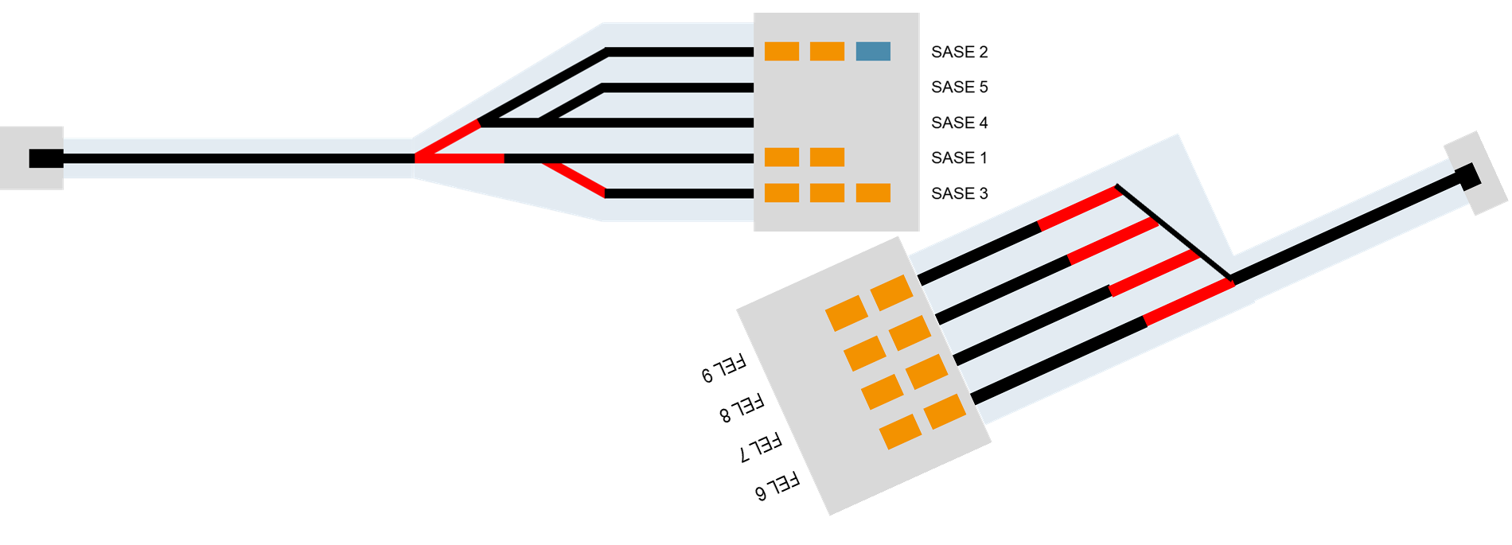
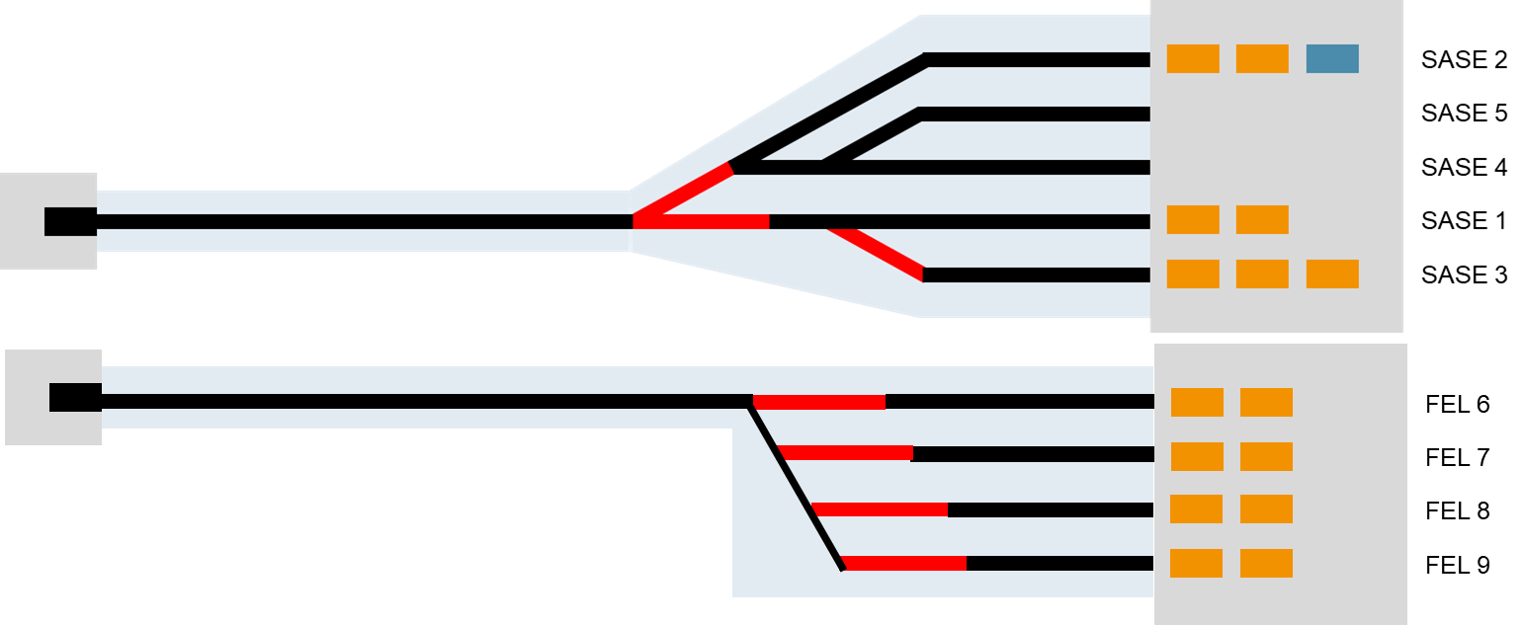
Example of two boundary conditions
Keep major facility layout
  Will not consider a 2nd facility separate from present one, e.g. by proposing a separate installation or a different orientation.
Stay with one accelerator tunnel and one accelerator
  Upgrade shall make use of the present accelerator, e.g. not propose a second, separate accelerator placed in a second tunnel.

Slide 20
Continuation of presently supported scientific applications
European XFEL made a significant investment into offering science opportunities for
  1. High Energy Density systems and science
    HED/HiBEF
    Fusion instrument
  These scientific applications require strong drivers (laser, pulsed fields) to generate the HED states which typically run at low repetition rates
  Albeit not really in line with the signature property of high repetition rate of European XFEL, these applications are considered very sucessful and received strong support.
  2. Soft x-rays
    SQS
    SCS/SXP
  When initially proposing European XFEL, it was natural to cover the range above FLASH. Meanwhile several other facilities have been built or are under construction with more dedication to this application area.
  However, applications have been very successful and a large fraction of attosecond science may be here.

Slide 21
Other boundaries
Operation shall enable the continuous and simultaneous operation of all FELs.
  Do not propose a layout that is based on switching between modes with only part of the facility adapted to these modes (e.g. large electron energy variation w/o possibility to adjust FELs for requested ħϖ
Available space in e.g. accelerator tunnel may lead to limitations of what can be included
…

Slide 22
Options

Slide 23
Option A: Upgrade accelerator mode of operation
SASE 2
SASE 5
SASE 4
SASE 1
SASE 3
Major upgrade activity
  Modify/renew accelerator (& beam distribution)

Slide 24
Option B: Renew scientific instrument suite
SASE 2
SASE 5
SASE 4
SASE 1
SASE 3
Major upgrade activity
  Modify/renew FELs, beam transports and scientific instruments
  Build out SASE 5 FEL, beam transport and scientific instruments

Slide 25
Option C: Build a 2nd fan for new FELs and scientific instruments
To be combined with:
Accelerator upgade, modify existing fan
SASE 2
SASE 5
SASE 4
SASE 1
SASE 3
FEL 6
FEL 7
Major activities
  Build new switchyard buildings
  Build new electron beamlines & associated infrastructure
  Build new science instruments
FEL 8
FEL 9

Slide 26
Facility upgrade proposal
Down-select a combination of options A, B and C fitting to the requirements defined from a scientific case for using the upgraded facility
Accelerator systems
  Refurbishment (needed)
  Maintain burst-mode operation or modify towards HDC-mode of operation
FEL sources
  Increasing number of FEL sources
  Refurbish existing ones
Beamlines
  Building new beamlines at new FEL sources
  Refurbish existing ones
Scientific instruments
  Building new scientific instruments at new FEL sources/beamlines
  Refurbish existing ones
Extend science support services and infrastructure

Slide 27
2nd FEL fan
Impact of 6° bend out of main accelerator → emittance growth → limitation to FEL process/gain ?
  For now we assume that at least std x-ray photon energies (0.5 – 12 keV) can be provided w/o issues
Layout of 2nd FEL fan will likely be not as proposed in initial PFV → plan approval change needed
For layout take inspiration from recently proposed UK XFEL scheme → initiated coll. with STFC
Dependence of fan layout on accelerator mode of operation to be determined (ideally only little dep.)
  Even the current accelerator has enough power to serve two FEL fans

Slide 28
Accelerator – cw or not-cw ?
The burst-mode operation of European XFEL (and of FLASH) is unique world-wide and no other facility followed us on this path towards higher repetition rate.
LCLS, SHINE and S3FEL (but as well UK XFEL proposal) have opted for a cw-mode of accelerator operation with base rate of 1 MHz.
  The benefit of such a realization is that you can share the beam to O(10) FELs / instruments with a 100 kHz rate. Such a pattern is much closer to laser/laboratory experiments.
There are expectations in our User communities that a European XFEL upgrade will follow this path. It might be more convincing to new User communities, too.
One the other hand we operate European XFEL very successfully and a not-cw (burst-mode) operation might have advantages
  Enable parameter/performance not accessible with cw-mode
  Based on very successful operation of European XFEL (e.g. beam modes and bunch dedication)
  Less energy consumption (?)
  Reduced upgrade cost & facility dead-time (?)

Slide 29
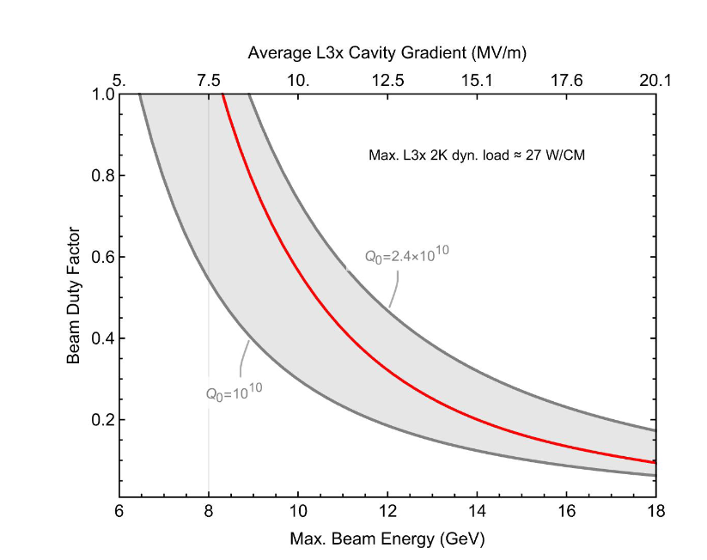
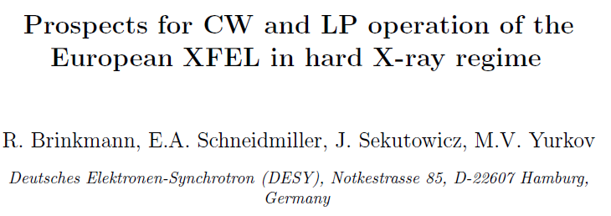
Higher Duty Cycle with new, modified cryo modules
Similar to LCLS-II / SHINE approach
  Optimized 2-phase He transport
  Improved cavity quality factor → reduced dynamic 2K load
1) Rebuild the entire linac for max energy reach at CW operation
  Very high cost ~1B€ (or more), very long dark time
2) Rebuild only L1+L2 (+new 2nd injector), keep L3 (optionally extend it by 16 modules from old L1+L2)
  CW high gradient in L1+L2 with high-performance modules, keep beam energy up to BC-II constant @ ~2. – 2.5GeV, very beneficial for beam dynamics
  L3 in CW mode at low gradient and/or higher g pulsed mode with possibly increased d.c.
NIM A 768 (2014)

Slide 30
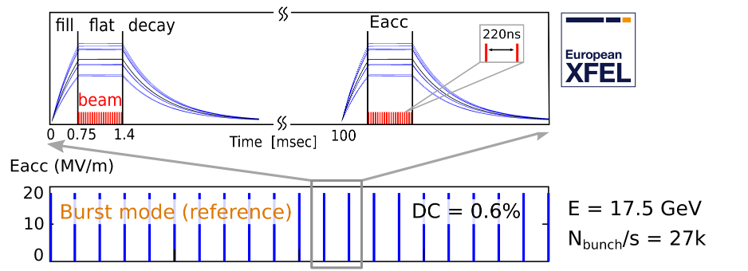
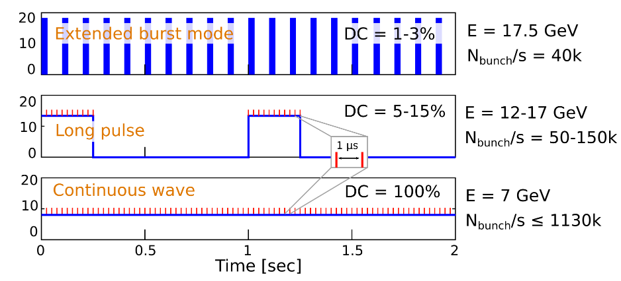
Electron bunch delivery
Superconducting LINAC
Photo-injector
RF-system
Cryo-system

Slide 31
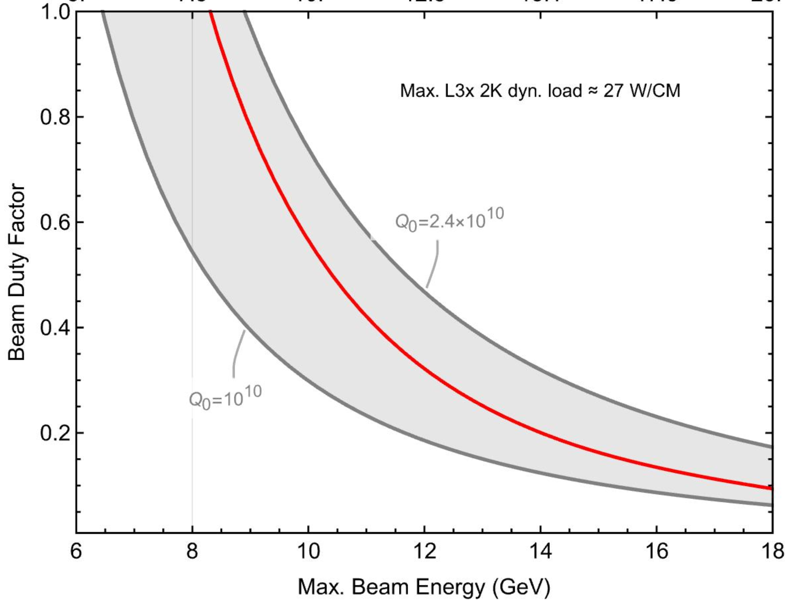
High Duty Cycle (HDC) mode – the best of both worlds ?
Combine the good features of pulsed operation with the opportu-nities of cw-operation.
Makes use of present accelerator with important extensions
  superconducting injector
  new RF system
  2nd cryo-plant
Possibility to tune working point
  true cw-operation
  high electron energy delivery in very long bursts O(100 ms).
10%

Slide 32

High Duty Cycle Upgrade
Current proposal baseline
CW-Injector
1.3 GHz module
3.9 GHz 3rd harm.
L1
4 cryomodules
(1 RF station)
L2
12 cryomodules
(3 RF stations)
L3x
96 cryomodules
(24 RF stations)
2 GeV
SASE2
A6
A29
A2
A3
A4
A5
A6
A25
AH1
A1
AH1
SASE1
New CW INJ
New LINAC (16 CM)
Existing LINAC (80+16 CM)
SASE3
New SRF injector
TS4i
How to maintain beam
quality
16x new CW-cryomodules
Based on new high-Q₀ cavities
How to modify the cryomodules
Maximum heat load supported by 2 phase pipe ?
What are the limits of our existing CMs
Maximum RF power supported by input couplers ?
How to optimize their operation
Slide prepared by J. Branlard/N. Walker/W. Decking (DESY)

Slide 33
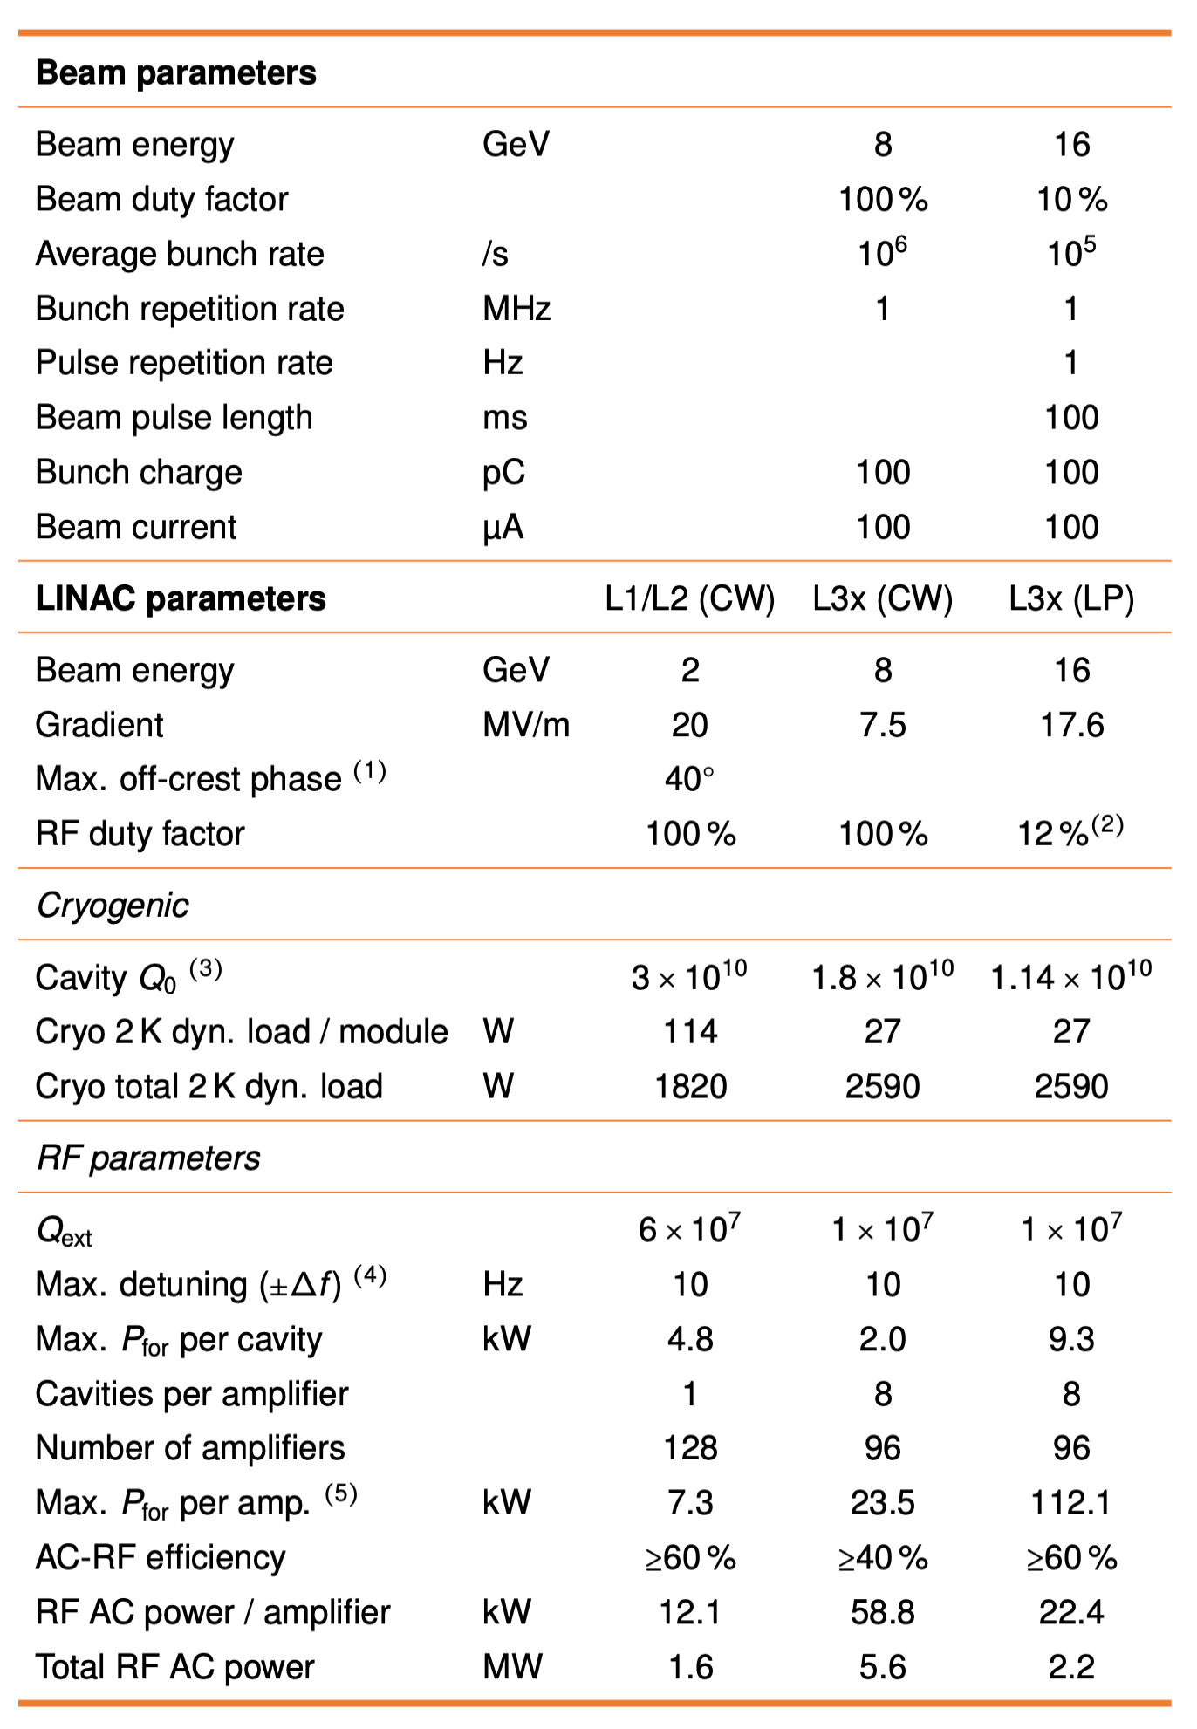
The (current) HDC Parameters
The HDC parameters published in the FOS Report are a consistent set based on the previous arguments
  But they remain just one example in a complex parameter space
They contain risk
  Cryogenic plant / 2K dyn. heat load in L3x
  Challenging RF Amplifier spec. (efficiency / margin)
  CW module performance
  (Photoinjector performance –not discussed here)
  CW 8 GeV AC power (RF+Cryo ~12 MW)
Going forward, we have a draft R&D plan to assess these risks
HDC FOS Report page 29

Slide 34
Advantages and disadvantages of HDC-mode
Advantages
Possibility to tune duty-cycle factor from 10 to 100%, with consequent adjustment of electron energy
Ability to reach high electron energies, while still being able to deliver 10⁵ electron bunches per second
Spreading over 100 ms the delivery of 10.000 pulses to 10 instruments with a pulse rate of 100 kHz becomes possible → this matches delivery patterns request for European XFEL and proposed at other, cw-mode facilities
Disadvantages
Still a non-continuous burst-mode like operation → stability, fatigue issues ?
Can we really make use of the large tunability ?
Possibility of defining beam properties for individual instruments may be reduced

Slide 35
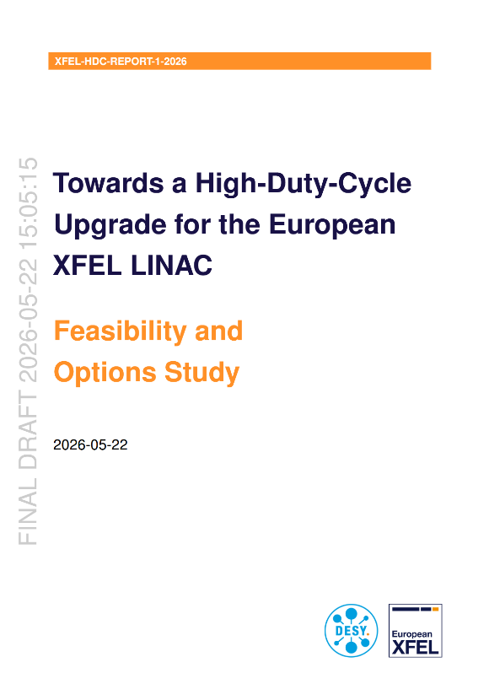
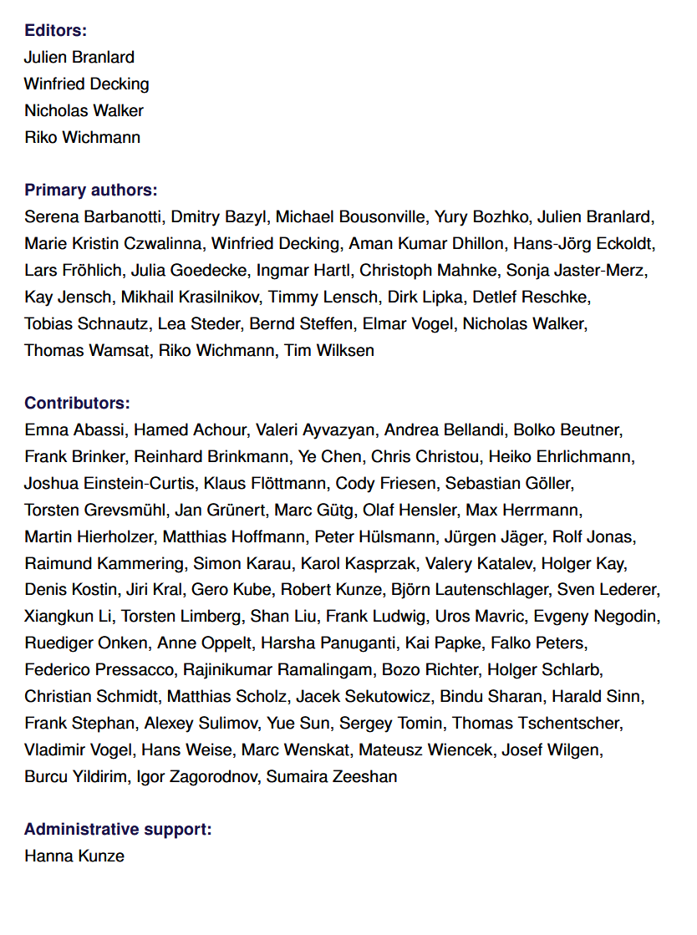
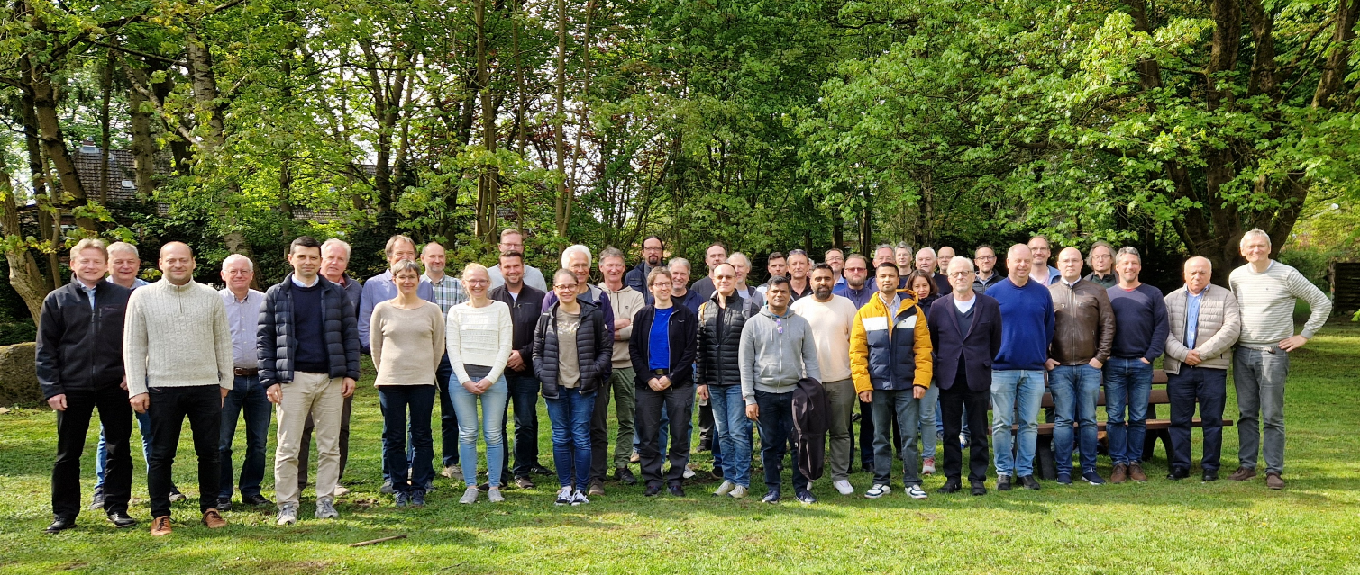
DESY engaged in R&D programme to develop HDC proposal
Started in 2022
Organized in 7 technical working groups
Experimental work at 6 test stands
Regular meetings and 6 workshops
Leading into FOS report
  FOS is not a facility proposal

Slide 36
Working Groups
General scope and top level parameters (Winni Decking, Nick Walker)
  Develop parameters and scope from basic scaling laws
Cryogenic solutions (Tobias Schnautz, Kay Jensch)
  How to cope with the increased heat load
CW-optimized 1.3 GHz modules (Serena Barbanotti, Lea Steder, Detlef Reschke)
  How to build a CW optimized cryo-module & how to modify the existing power couplers
RF solutions (Christian Schmidt, Hans-Joerg Eckoldt, Julien Branlard, Michael Bousonville)
  How to build an RF system capable of CW and pulsed mode into the existing tunnel
CW Photoinjector (Dmitry Bazyl, Mikhail Krasilnikov, Elmar Vogel)
  How to develop a CW injector with sufficient beam quality and beam current
Timing and Controls (Lars Froehlich, Tim Wilksen)
  How to deal with a continuous and increased data stream
Diagnostics and Feedbacks (Marie Kristin Czwalinna, Dirk Lipka)
  Identify challenges and chances coming with the increased duty cycle

Slide 37
Follow-up of HDC-colloquium
HDC-colloquium on Jun 02, 2026
  Organized to disseminate information about the R&D work performed at DESY over last 4 years to study the technical implementation, details and options for the modification of the accelerator layout in order to enable a HDC-mode of operation.
  Broad discussion of properties and limitations of the HDC-mode of operation.
Follow-up meeting on Jun 16, 2026
  Discussion of issues related to ‚critical‘ topics related to HDC-mode
    Max. bunch charge of 100 pC (beam current 100 µA) → expectation of smaller x-ray pulse energies
    1 Hz operation → instabilities, difficult setting for tuning or feedback
    Keeping the full flexibility in duty cycle (10 – 100%) → technology impact & boundaries; tuning range for FELs
    Keeping ‚burst-mode‘ option
  Feedback to HDC team to look into options
    Impact of increasing beam current to 200-250 µA
    Impact of 10 Hz operation
    Impact of narrowing down DC tuning to 10-20% (corresponding to 14-16 GeV)

Slide 38
Extending the present burst-mode
An alternative might be to extend the present burst-mode of operation
  Longer bursts (few ms ?)
  Higher rep rate (9 MHz)
  Higher electron energy (20 GeV)
  …
Not yet worked upon (due to time/personal constraints)
Rather an extension of present accelerator than an upgrade ?

Slide 39
Extended RF Burst Principal Limitations (at 17.5 GeV beam energy)
Approx. beam duty cycle limit | Limiting HW | Way out
1 % | RF Gun | New RF Gun
1.5 % | Cryo Plant | Operate 2nd (redundant) cryo plant string (+ 3 MW) + new cold box
1.8 % | High Power RF System | New HPRF
3 % | Cryo Module (2 phase pipe) | New Cryo Modules
An approx. 1% duty cycle in the burst mode seems to be a reasonable limit for reliable and sustainable operation, with the new GUN5 we already increased from 0.6% to 0.8%
Slide prepared by W. Decking (DESY)

Slide 40
FELs – Beamlines – Scientific instrumentaton – User services
There is already a lot of development started and foreseen
  SCUs
  Pump laser upgrades
  Detector 2nd generation (XSTREAM Call for EoI)
  …
More to come as proposal narrows down
  DAQ realization, use of on-chip data processing, need for feedback to maintan stability with long pulses
  Analysis of thermo-mechanical issues due to long pulse trains
  …
The upgrade proposal needs to be coherent in the sense that the proposed parameters need to be suported by all systems.
… more detail to come

Slide 41
Upgrade path

Slide 42
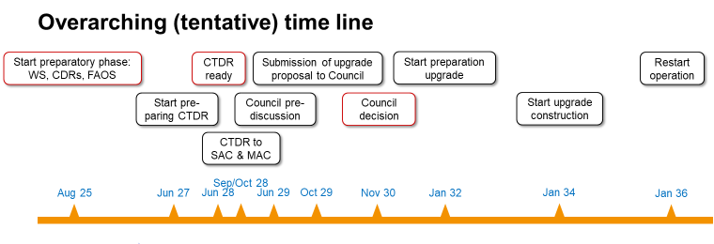
Time line & CTDR
Best possible scenario; depends on Shareholder agreement
Timeline for CDTR preparation
  summer 2028: DRAFT CTDR ready
  fall 2028: to MAC/SAC
  Summer 2029: CTDR supplement
  Oct 2029: CTDR to Council
  Nov 2030: Council decision
CTDR describes
  the upgrade proposal, ideally one option,
  the supporting science case, and the technical elements of the upgrade itself.
CTDR supplement for estimate of costs, effort and timeline approx. 1 yr later.
The CTDR might need to be complemented by other reports addressing
  Societal relevance
  Innovation potential
  …

Slide 43
How to get there
Science case and down-selection of options
  Engage with User community to identify attractive science applications, and to define their requirements and best possible implementation.
    Expert meetings (present Users, mostly technique oriented)
    Science workshops (largely oriented along big themes, but with specific sessions)
    Reports from the workshops
    Letter of intent/support to feature specific applications
Develop techniques to a point where a proposal can be made with some certitude
  Accelerator
  FELs
  Instrumentation: detectors, pump lasers
  Operation modes (?)
Bring science cases and technical opportunities together and build a coherent upgrade proposal
  This includes a down-selection of technical options
Get support for upgrade proposal from User communities and Advisory committees

Slide 44
Discussion

Slide 45
Break

Slide 46
Mapping our applications (exercise)

Slide 47

Brainstorming exercise
Objective: map scientific applications onto parameter space
  Let’s start with what we are doing today (define a starting point)
  Then (if time permits) add new applications (or ideas for
  We prepared flipcharts for different parameter spaces:
    Repetition rate vs photon energy
    Average rate vs photon energy
    Pulse energy vs photon energy
    Pulse duration/time resolution
Suggestion to work in group at these 4 panels -> move to next panel after 10 min for current situation. Then add 10 min for new applications.
Finally a (brief) plenary discussion on findings
40 min
10 min

